Slide 1
Azure Databricks + Azure Data Factory
Monday, February 1st 2021 – 18:30 (Brasilia)
- Diego Eick Moreira - Fabio Krohn Jr.

Slide 2
Agenda
Possible integrations
Best practices
Use cases
Q&A

Slide 3
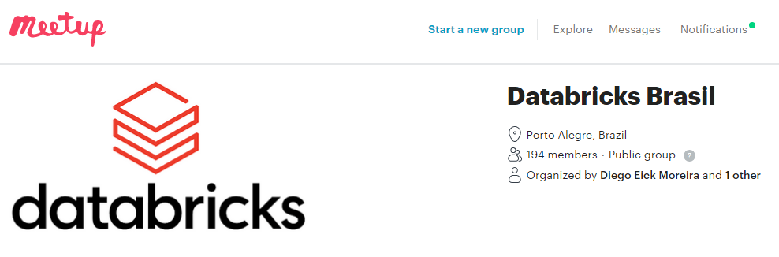
Databricks Brasil

Slide 4
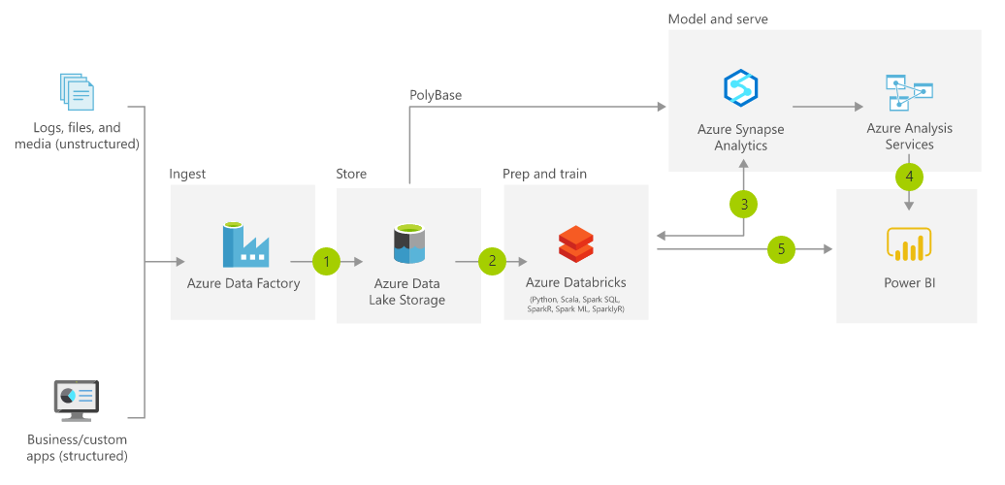
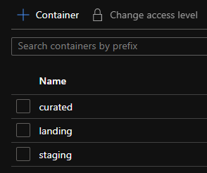
Modern Data Platforms

Slide 5
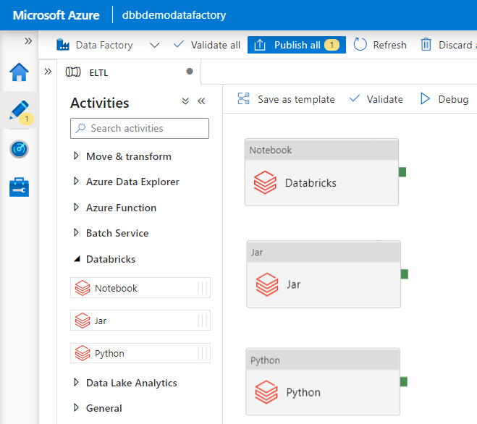
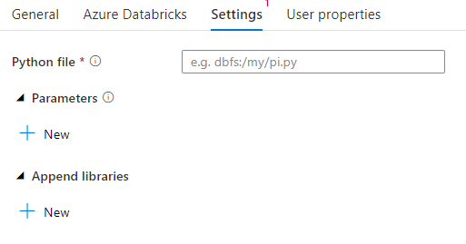
Possible Integrations
Execute a Python Script
path of .py file

Slide 6
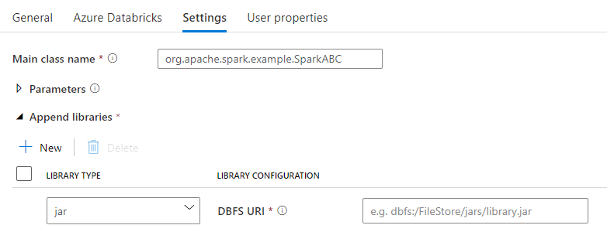
Possible Integrations
Execute a Spark Jar in your Azure Databricks.
path of jar file
main class name

Slide 7
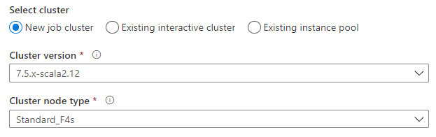
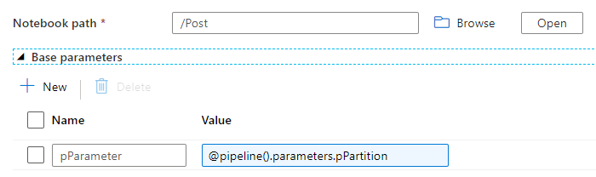
Possible Integrations
Execute a Databricks notebook.
select cluster type (interactive, job, pool)
pass parameters

Slide 8
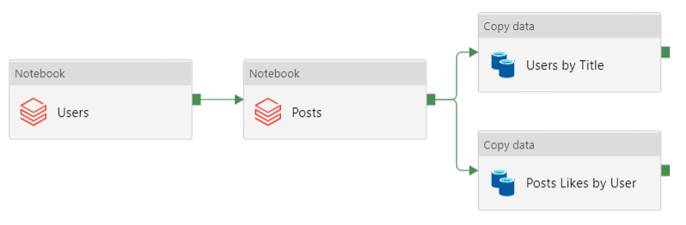




Possible Integrations
Use Cases:
Using interactive/pool cluster
cluster active
inactive

Slide 9
Possible Integrations
Use Cases:
Using job cluster
cluster 1
cluster 2

Slide 10
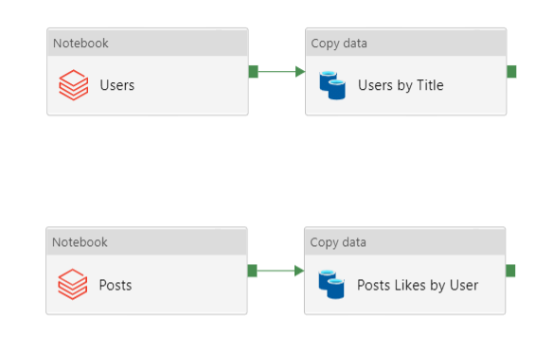
Possible Integrations
Use Cases:
Using job cluster
cluster 1
cluster 2

Slide 11
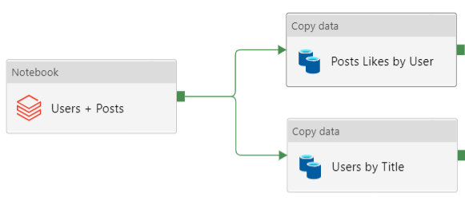
Possible Integrations
Use Cases:
Using job cluster
cluster 1

Slide 12
Demo

Slide 13
Thanks
Diego Eick Moreira (diego@codehb.com)
Fabio Krohn Jr. (fabio@codehb.com

